Slide 1
Analysis of presence-type data
SSA 200

Slide 2
Presence only vs. Presence-absence data
Example 1: A National Park office often gets reports from people who have seen wolverines in the park. They keep track of the locations and dates of these sightings.
Example 2: A researcher conducts point counts for birds in the same forest plot every month from May – July each year. During point counts they make an effort to detect and record every species within the survey window.
Example 3: A natural history museum has plant specimens that contain information about the location and date of collection.
Example 4: iNaturalist has over 29,000 recorded observations of Monarch butterflies from across their range dating back to 2009.

Slide 3
Presence only vs. Presence-absence data
Example 1: A National Park office often gets reports from people who have seen wolverines in the park. They keep track of the locations and dates of these sightings.
Example 2: A researcher conducts point counts for birds in the same forest plot every month from May – July each year. During point counts they make an effort to detect and record every species within the survey window.
Example 3: A natural history museum has plant specimens that contain information about the location and date of collection.
Example 4: iNaturalist has over 29,000 recorded observations of Monarch butterflies from across their range dating back to 2009.
Presence only
Presence-absence
Presence only
Presence only

Slide 4
Do I have true absences in my data?
Presence-absence
Presence only
Replicated surveys?
Number of years?
Yes
No
few
lots
Logistic regression
Site occupancy model
Dynamic occupancy model
Presence type models
Always check specific model assumptions!
Notes:
By the end of the lecture, you should have information to allow you assess presence type models.

Slide 5
Presence only data

Slide 6
Example questions
Where is this species found? (current, future condition)
What ecological factors best predict its occurrence? (stressors/ecological needs)
Notes:
I thought that we weren’t talking about the future projections until lecture 7? This is confusing

Slide 7
Example data sources
Information about where/when a species was detected but NOT where/when it was looked for but not found
Opportunistic reporting by the public
Some eBird checklists (*complete checklists = presence-absence data)
Historical records (e.g. museum specimens, field notes)

Slide 8
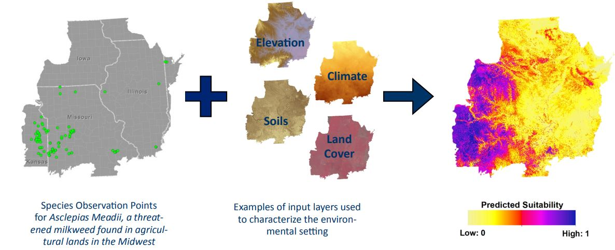
Common analysis approaches
Species Distribution Modeling
Inputs
Outputs
Notes:
What is this image from? Credit the image. This is a good general conceptual diagram of all of the methods.

Slide 9
Presence data models
Method(s) | Model/software name | Data type
Climatic envelope | BIOCLIM | Presence-only
Gower Metric | DOMAIN | Presence-only
Ecological Niche Factor Analysis (ENFA) | BIOMAPPER | Presence/background
Maximum Entropy | MAXENT | Presence/background
Genetic algorithm | GARP | Presence/pseudo-absence
Regression: Generalized linear model (GLM) and Generalized additive model (GAM) | GRASP | Presence/absence
Artificial Neural Network (ANN) | SPECIES | Presence/absence
Classification and regression trees (CART), GLM, GAM and ANN | BIOMOD | Presence/absence
Boosted decision trees | (implemented in R) | Presence/absence
Multivariate adaptive regression splines (MARS) | (implemented in R) | Presence/absence
Notes:
Here is a giant list of the models you might run into; now, we’ll break it down into a few examples.

Slide 10
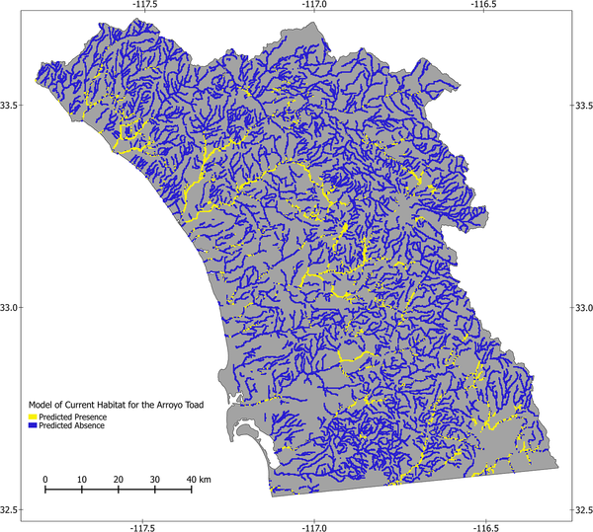
Modeled current distribution of the arroyo toad in southwestern California.
Treglia ML, Fisher RN, Fitzgerald LA (2015) Integrating Multiple Distribution Models to Guide Conservation Efforts of an Endangered Toad. PLOS ONE 10(6): e0131628. https://doi.org/10.1371/journal.pone.0131628
https://journals.plos.org/plosone/article?id=10.1371/journal.pone.0131628
Notes:
We obtained locality data for arroyo toads from the U.S. Fish and Wildlife Service (http://www.fws.gov/carlsbad/GIS/CFWOGIS.html) and we also used museum records from the following institutions, accessed through the HerpNet data portal (http://herpnet.org/): California Academy of Sciences; Natural History Museum of Los Angeles County; San Diego Natural History Museum; Smithsonian National Museum of Natural History; and University of California, Berkeley, Museum of Vertebrate Zoology. We included data from Cleveland National Forest [43,44], and our own surveys conducted as part of the U.S. Geological Survey (USGS) Amphibian Research and Monitoring Initiative (ARMI; http://armi.usgs.gov/) and the San Diego Monitoring and Management Program (SDMMP; http://sdmmp.com). Datasets were accessed in September 2013.

Slide 11
Assumptions
Temptation for overfitting
The number of terms in the model should not exceed the number of observations
Consider ecologically-relevant environmental variables to include
Potential observation bias
Be careful with extrapolation (both spatial and temporal)
Omission & commission errors
Notes:
Interpreting outputs using literature example

Slide 12
Overfitting
Simpler
Worse fit
More useful
More complex
Best fit
Less useful
Notes:
Simpler models usually depict more simple trends

Slide 13

Overfitting

Slide 14
Assumptions
Temptation for overfitting
The number of terms in the model should not exceed the number of observations
Consider ecologically-relevant environmental variables to include
Potential observation bias
Notes:
Interpreting outputs using literature example

Slide 15
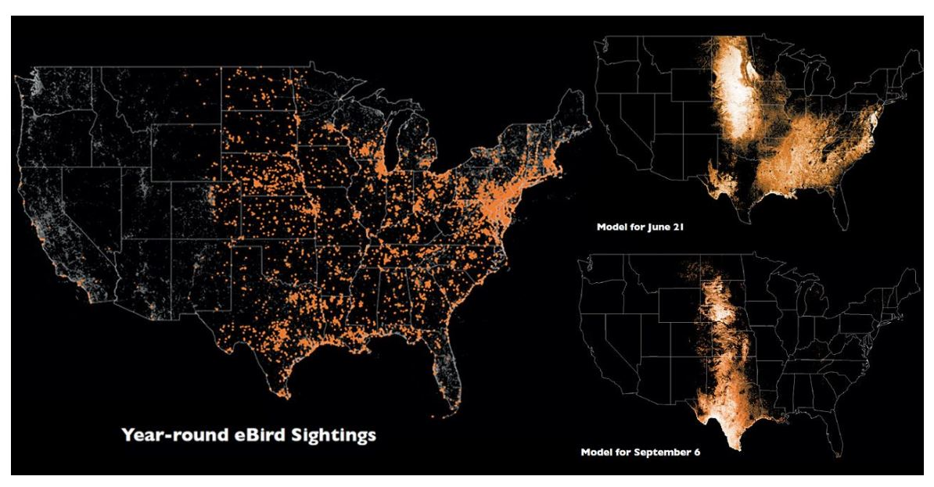
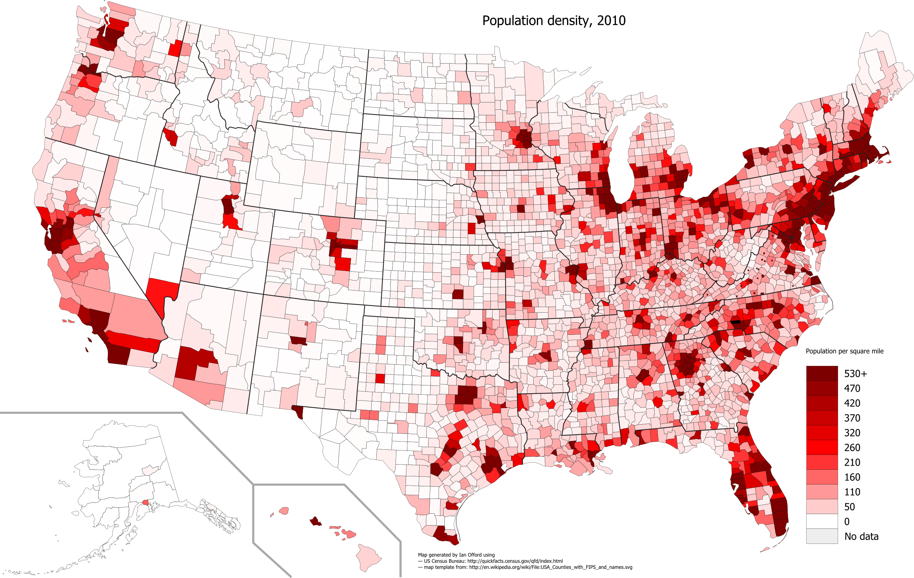
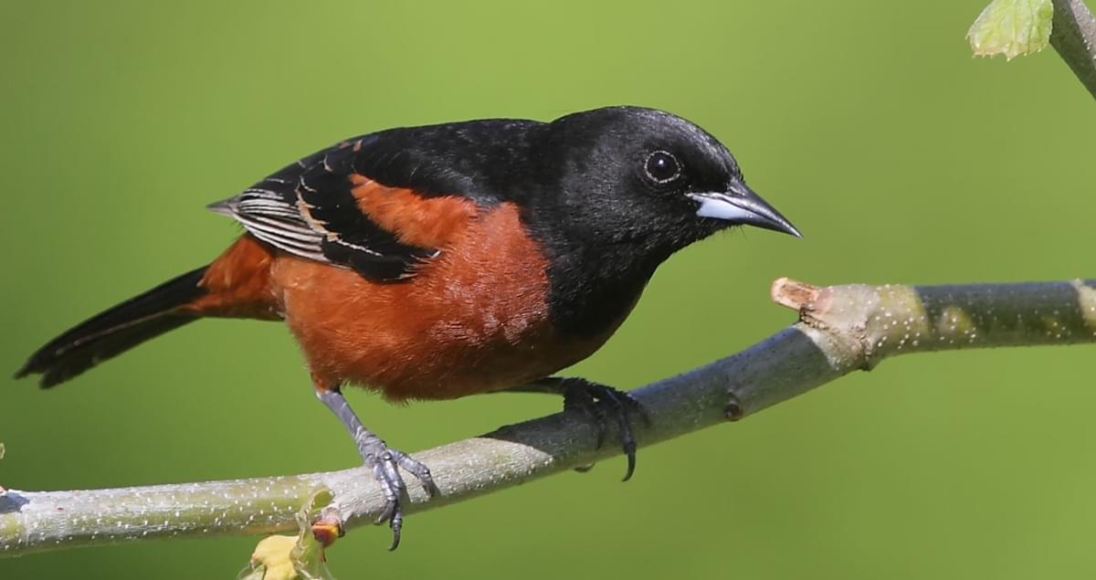
Observation bias
Population density, 2010 US Census
Notes:
Ebird sightings of orchard oriole

Slide 16
Enhance your data!
Trim or systematically reduce your points based on known biases
Several methods to generate “pseudo-absences”
Entire range/study area
Within some specified distance of each observation
Constrained by environmental variables
Place random points from the background around your observations
Points similar based on the climatic/biological datasets, but where no observation occurred

Slide 17
Assumptions
Temptation for overfitting
The number of terms in the model should not exceed the number of observations
Consider ecologically-relevant environmental variables to include
Potential observation bias
Qualify any extrapolation you make

Slide 18
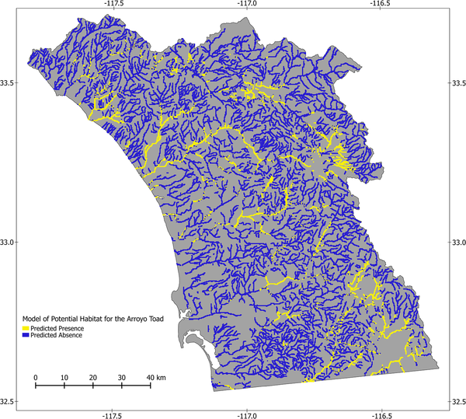
Extrapolation
Notes:
In conservation you might extrapolate to an area where a species was lost – in that case, for eg here for Arroyo Toads, you could then make conservation habitat a part of it.

Slide 19
Assumptions
Temptation for overfitting
The number of terms in the model should not exceed the number of observations
Consider ecologically-relevant environmental variables to include
Potential observation bias
Qualify extrapolation (have a good reason, i.e., translocation site)
Omission & commission errors
Notes:
Interpreting outputs using literature example

Slide 20
Omission and commission error
Actual geographic distribution
Predicted geographic distribution
Underprediction,
or Omission
Overprediction,
or Commission

Slide 21
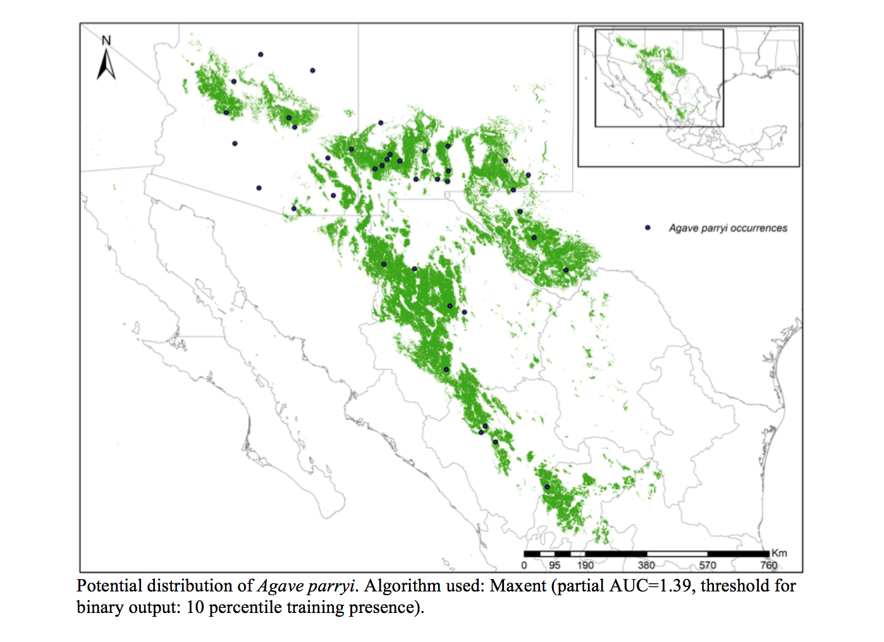
Omission and commission error
Underprediction,
or Omission
Threshold statistics you might run into if you use a subset of data to test the models:
true positive (TP) rate (TPR) = TP/P
false positive rate (FPR) =FP/N
accuracy (ACC) = (TP + TN) / (P + N)
Model performance statistics you will run into:
area under the receiver operating curve (AUC): range 0.5–1.0. Models values >0.9 are considered to have high performance
Predicted geographic distribution
Overprediction,
or Commission?
Gómez-Ruiz E, Lacher T. (2016) Modelling the potential geographic distribution of an endangered pollination corridor in Mexico and the United States. Diversity and Distributions 23(1): https://doi.org/10.1111/ddi.12499

Slide 22
Presence-absence data

Slide 23
Example data sources
Information about where/when a species was detected AND where/when it was looked for but not found
Transect surveys
Point counts
Any other systematic survey effort
Complete eBird checklists

Slide 24
Example research questions
What habitat characteristics are associated with species presence? (ecological needs)
What is the distribution of a species in a given area? (Representation, Redundancy)
How has that distribution shifted over time? (e.g. due to habitat loss, invasive species, etc.)
What is the extent of the species range?
To what extent does this species co-occur with other species?
Species interactions, exclusion, etc.
How many species are found in this area?
Notes:
Difficult to parse apart observation/detection probability from true occurrence probability

Slide 25
Common analysis approaches
Logistic regression

Slide 26
Logistic regression
A type of generalized linear model where the y variable is drawn from the Binomial distribution
Response variable consists of 1s and 0s (“successes” and “failures”)
Forms the basis for many more complex models
Occupancy analysis
Survival analysis
Resource selection

Slide 27
Common analysis approaches
Logistic regression
Site-occupancy models

Slide 28
When is occupancy analysis appropriate?
Presence/absence data
Multiple sites
Repeated visits in a closed period
Assume that true occupancy of a given site does not change between visits
Need to be collected within a short enough time-frame for this to be reasonable—depends on species of interest
Notes:
Multiple sites not necessary for the analysis, but needed to estimate effect of ecological covariates.

Slide 29
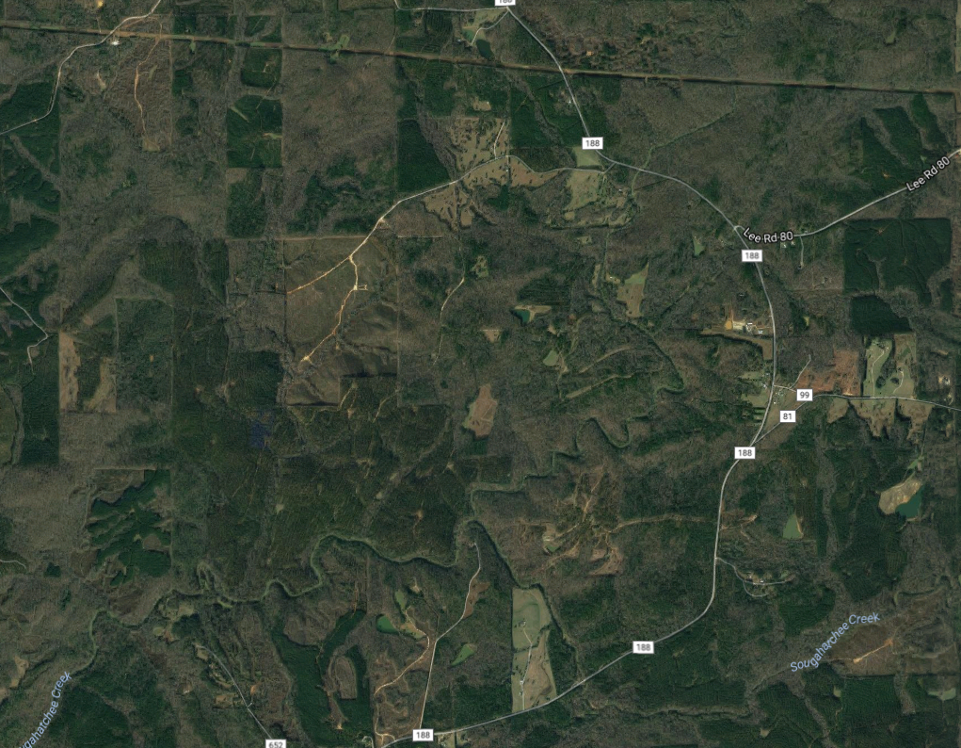
Sampling
Replication is key
Spatial – multiple, randomly selected sites or sampling units within the area of interest
Temporal – repeated visits to each site
Visit 1
Visit 2
Visit 3
Notes:
Difficult to parse apart observation/detection probability from true occurrence probability

Slide 30
Your datasets may look similar to these
Site | Date | Species detected?
A | 6/27/2006 | Yes
B | 6/28/2006 | Yes
C | 6/25/2006 | No
A | 7/3/2006 | No
B | 7/5/2006 | Yes
C | 7/2/2006 | No
A | 7/12/2006 | Yes
B | 7/11/2006 | Yes
C | 7/13/2006 | Yes
Site | Visit 1 | Visit 2 | Visit 3
A | 1 | 0 | 1
B
C
Site | Visit 1 | Visit 2 | Visit 3
A | 1 | 0 | 1
B | 1 | 1 | 1
C
Site | Visit 1 | Visit 2 | Visit 3
A | 1 | 0 | 1
B | 1 | 1 | 1
C | 0 | 0 | 1
Site | Visit 1 | Visit 2 | Visit 3
A
B
C
Notes:
Difficult to parse apart observation/detection probability from true occurrence probability

Slide 31
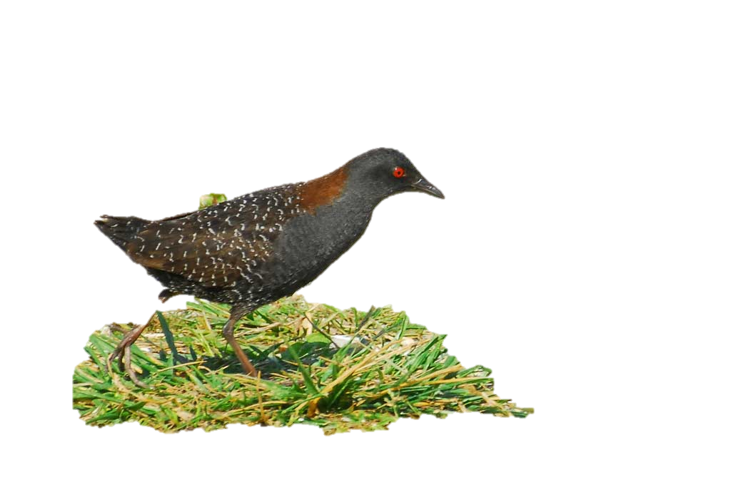
How an observer surveys for eastern Black Rail
?
?
Visit 1
?
?
?
?
?
Visit 2
?
?
?
Notes:
We don’t have the future data, but we can infer the future based on the past data collection and environment

Slide 32
Species is present
Species is not present
Detected
Not detected
Detected
Not detected
Notes:
Potential of underestimating occupancy is this is not taken into account

Slide 33
Assumptions
Sites are closed to changes in occupancy between sampling occasions
Appropriate duration between surveys
Detection process is independent at each site
Appropriate distance between sites
Both detection probability and occupancy probability are constant across all sites OR explained by covariates
For example, if we think rainfall influences our ability to detect the species, then rainfall should be included in the model

Slide 34
Model parameters
ψ_{i} = probability that site i is occupied
p_{i,t} = probability of detecting the species in site i at time t, given that the species is present
* Check text and captions for notation definitions within each paper – not always consistent!

Slide 35
How an observer surveys for eastern Black Rail
Occupancy probability (ψ)
?
?
Visit 1
extinction
?
?
colonization
Detection probability (p)
?
?
?
Visit 2
?
?
?
$ε_{i,t}^{R}=\left({P(ph}_{i,t})×\left(ε_{i,t}^{b}+{ph}_{i,t}\right)\right)+\left(\left(1−{P(ph}_{i,t})\right){×ε}_{i,t}^{b}\right)$,
Notes:
We don’t have the future data, but we can infer the future based on the past data collection and environment

Slide 36
Model outputs
Occupancy probability
Odds
Notes:
Difficult to parse apart observation/detection probability from true occurrence probability

Slide 37
What influences occupancy probability?
Potential stressors and threats included as covariates
Site characteristics (e.g. land cover)
Weather (rainfall, temperature)
Distance to other occupied sites
… etc. …
Effect of covariates often expressed as odds

Slide 38
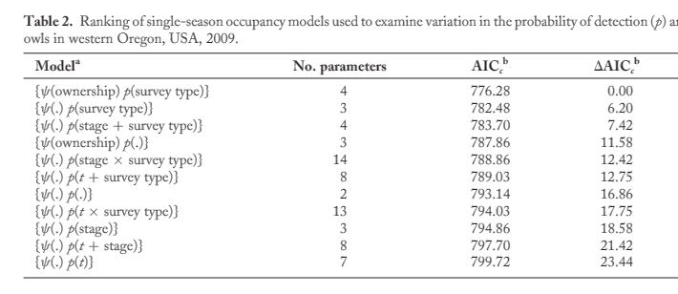
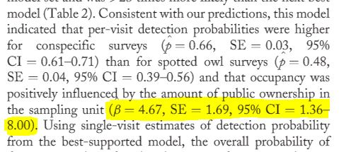
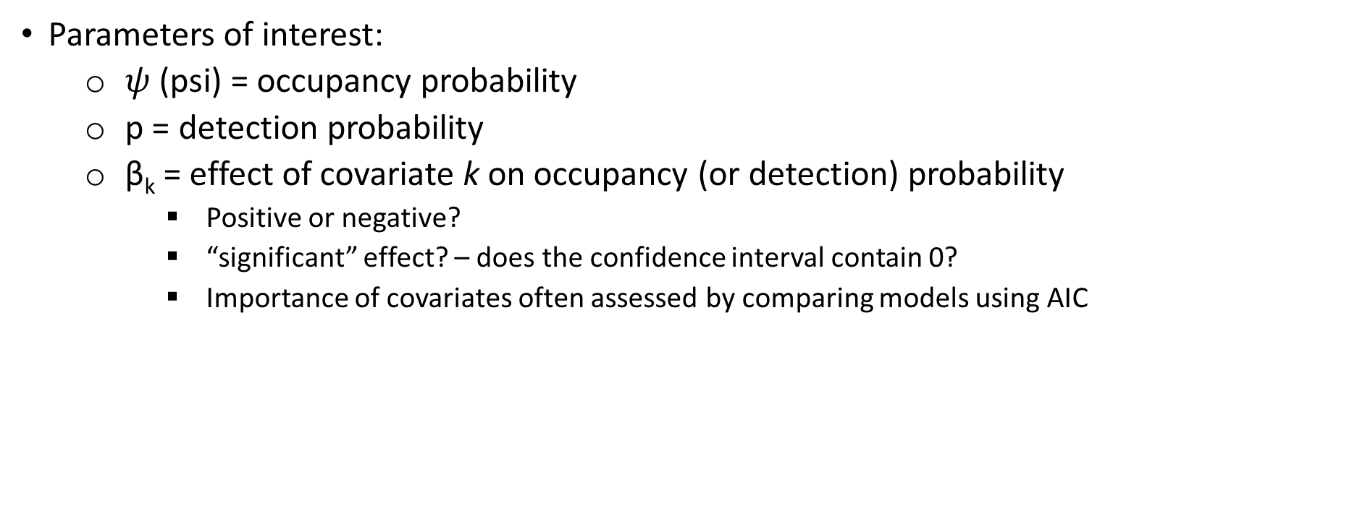
Interpreting model outputs
Parameters of interest:
$ψ$ (psi) = occupancy probability
p = detection probability
β_{k} = effect of covariate k on occupancy (or detection) probability
Positive or negative?
“significant” effect? – does the confidence interval contain 0?
Importance of covariates often assessed by comparing models using AIC
Use the AIC table to determine the best model
Wiens et al 2011

Slide 39
Example
Occupancy example
Notes:
Difficult to parse apart observation/detection probability from true occurrence probability

Slide 40
Why estimate occupancy?
Abundance can tell you more about species status, site use, and ecology
More difficult to collect abundance data (time, money) and therefore often limited in spatial and/or temporal scope
Presence/absence data is typically:
Less intensive to collect
Cheaper
Covers larger area/time scale
Can be more practical depending on objectives

Slide 41
Common analysis approaches
Logistic regression
Site-occupancy models
Dynamic occupancy models
Notes:
Difficult to parse apart observation/detection probability from true occurrence probability

Slide 42
Dynamic occupancy models
Estimate change in occupancy over time (colonization and extinction)
1
P
1
0
P
E
1
C
E
0
1
1 - C
0
Time 1
Time 2
Time 3

Slide 43
Dynamic occupancy models
Estimate change in occupancy over time (colonization and extinction)
1
P
1
0
P
E
1
E
0
C
1
1 - C
0
Time 1
Time 2
Time 3

Slide 44
Common analysis approaches
Logistic regression – lacking spatial and/or temporal replication
Site-occupancy models – single year, several sites
Dynamic occupancy models – several years, several sites
Account for imperfect detection
Assume detection is perfect
Notes:
Difficult to parse apart observation/detection probability from true occurrence probability

Slide 45
Do I have true absences in my data?
Presence-absence
Presence only
Replicated surveys?
Number of years?
Yes
No
few
lots
Logistic regression
Site occupancy model
Dynamic occupancy model
Presence type models
Always check specific model assumptions!
Notes:
By the end of the lecture, you should have information to allow you assess presence type models.

